Slide 1
Pytorch Tutorial
Zhuo Su and Lam Huynh
Center for Machine Vision and Signal Analysis

Slide 2

Outline
1. What and why Pytorch?
2. Installation
3. How to create and train your model?
4. Example
5. References

Slide 3

What is Pytorch?
A deep learning framework released in October of 2016.
Pytorch is based on a ML framework called Torch. Torch is written in Lua, that is an obscure and aging language. A newer version, written in Python was created, so call the Pytorch.
Pytorch builds by many companies and universities, not just Facebook.

Slide 4
The backbone of Pytorch framework
Provide popular network architectures, datasets, and image transformation operations
The top-level tensor library
torch
torchvision
High-level classes for building neural networks
torch.nn
torch.autograd
torch.optim
torch.utils
Standard loss functions, activation functions and convolution operations in functional form.
torch.nn.functional
Suport taking the derivative for Pytorch tensor
Provide common optimizer e.g. SGD, Adam
Provide utilities classes like Dataset, DataLoader..

Slide 5
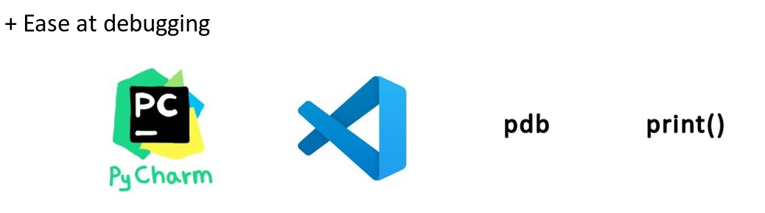
Why using Pytorch?
1. Very easy for beginner to get start.

Slide 6
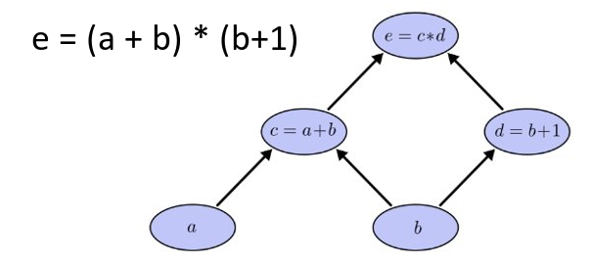
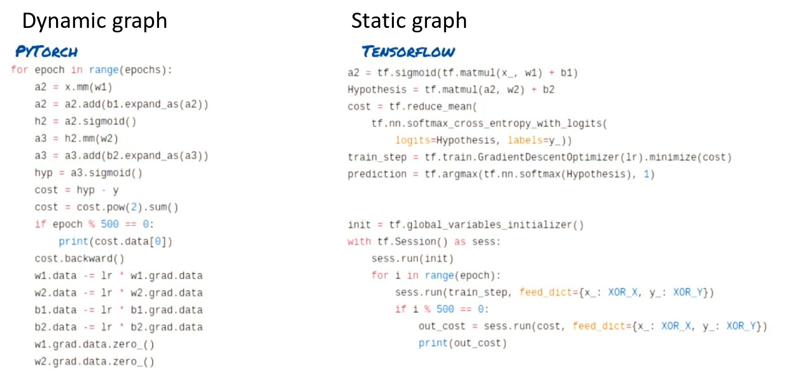
Why using Pytorch?
2. Great flexibility via the use of dynamic computational graph.​
Fundamentally, to optimize DNN, we need to calculate the derivatives using the chain rule. In order to do that, DL framework need to create a computational graph, that contain the function operations at its nodes.

Slide 7
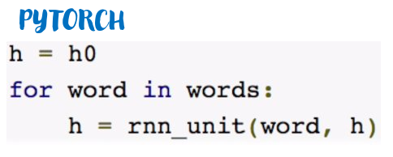
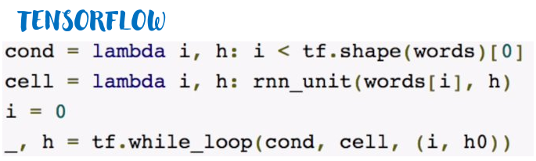
Why using Pytorch?
Static graph define the computational graph before running the computation, while dynamic graph do that on-the-fly.

Slide 8

Installation
Anaconda is a python package manager
Built-in Jupyter notebook
Very easy to install and manage python package

Slide 9

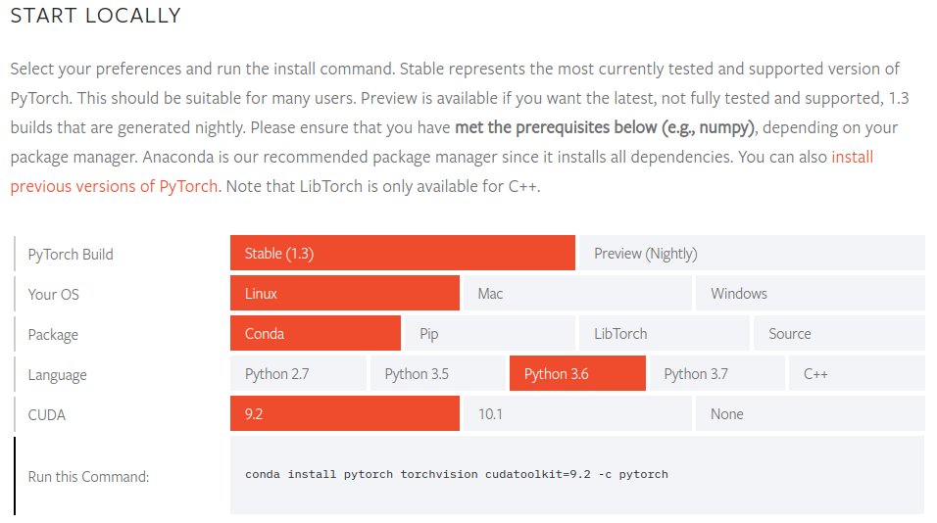
Installation
1. Download and install anaconda
2. Create and activate a conda environment
conda create –n pytorch python=3.7
conda activate pytorch
3. Go to https://pytorch.org/get-started/locally/ and choose your configuration​

Slide 10
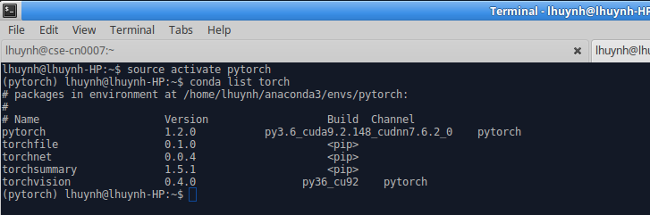
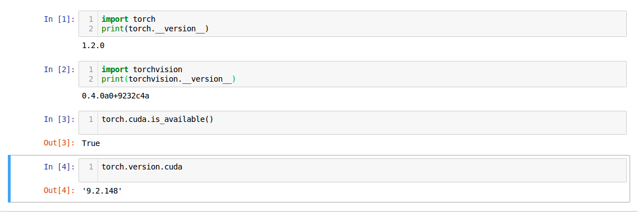
Installation
If error occurs, try to GG the error. 95% that your error was resolved by someone else.
If you cannot find the solution, you can contact Lam or Zhou, with the attach error.

Slide 11
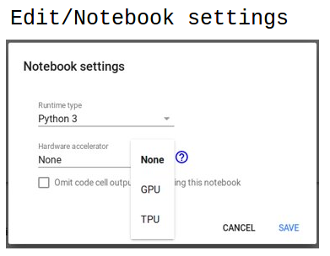
Ready for use resources
Computer classrooms (e.g. TS135, TS137)
Windows VMWare Horizon Client instance
CSC Notebook: https://notebooks.csc.fi/
Life circle 10 hours.
CPU only, pytorch 1.12, torchvision 0.4.0
Login with your Haka account
Google Colab: https://colab.research.google.com/notebooks/welcome.ipynb
Life circle 12 hours.
CPU + GPU, pytorch 1.3, torchvision 0.4.1 (GPU disconnect after 60 minutes idle)
Login with your GG account
CPU only, pytorch 1.13, torchvision 0.4.1
CPU only, pytorch 1.12, torchvision 0.4.0
DeepLearning (Ubuntu 16.04) VM Ware instance , password: DeepLearning

Slide 12
Part 2: Using Pytorch:

Slide 13
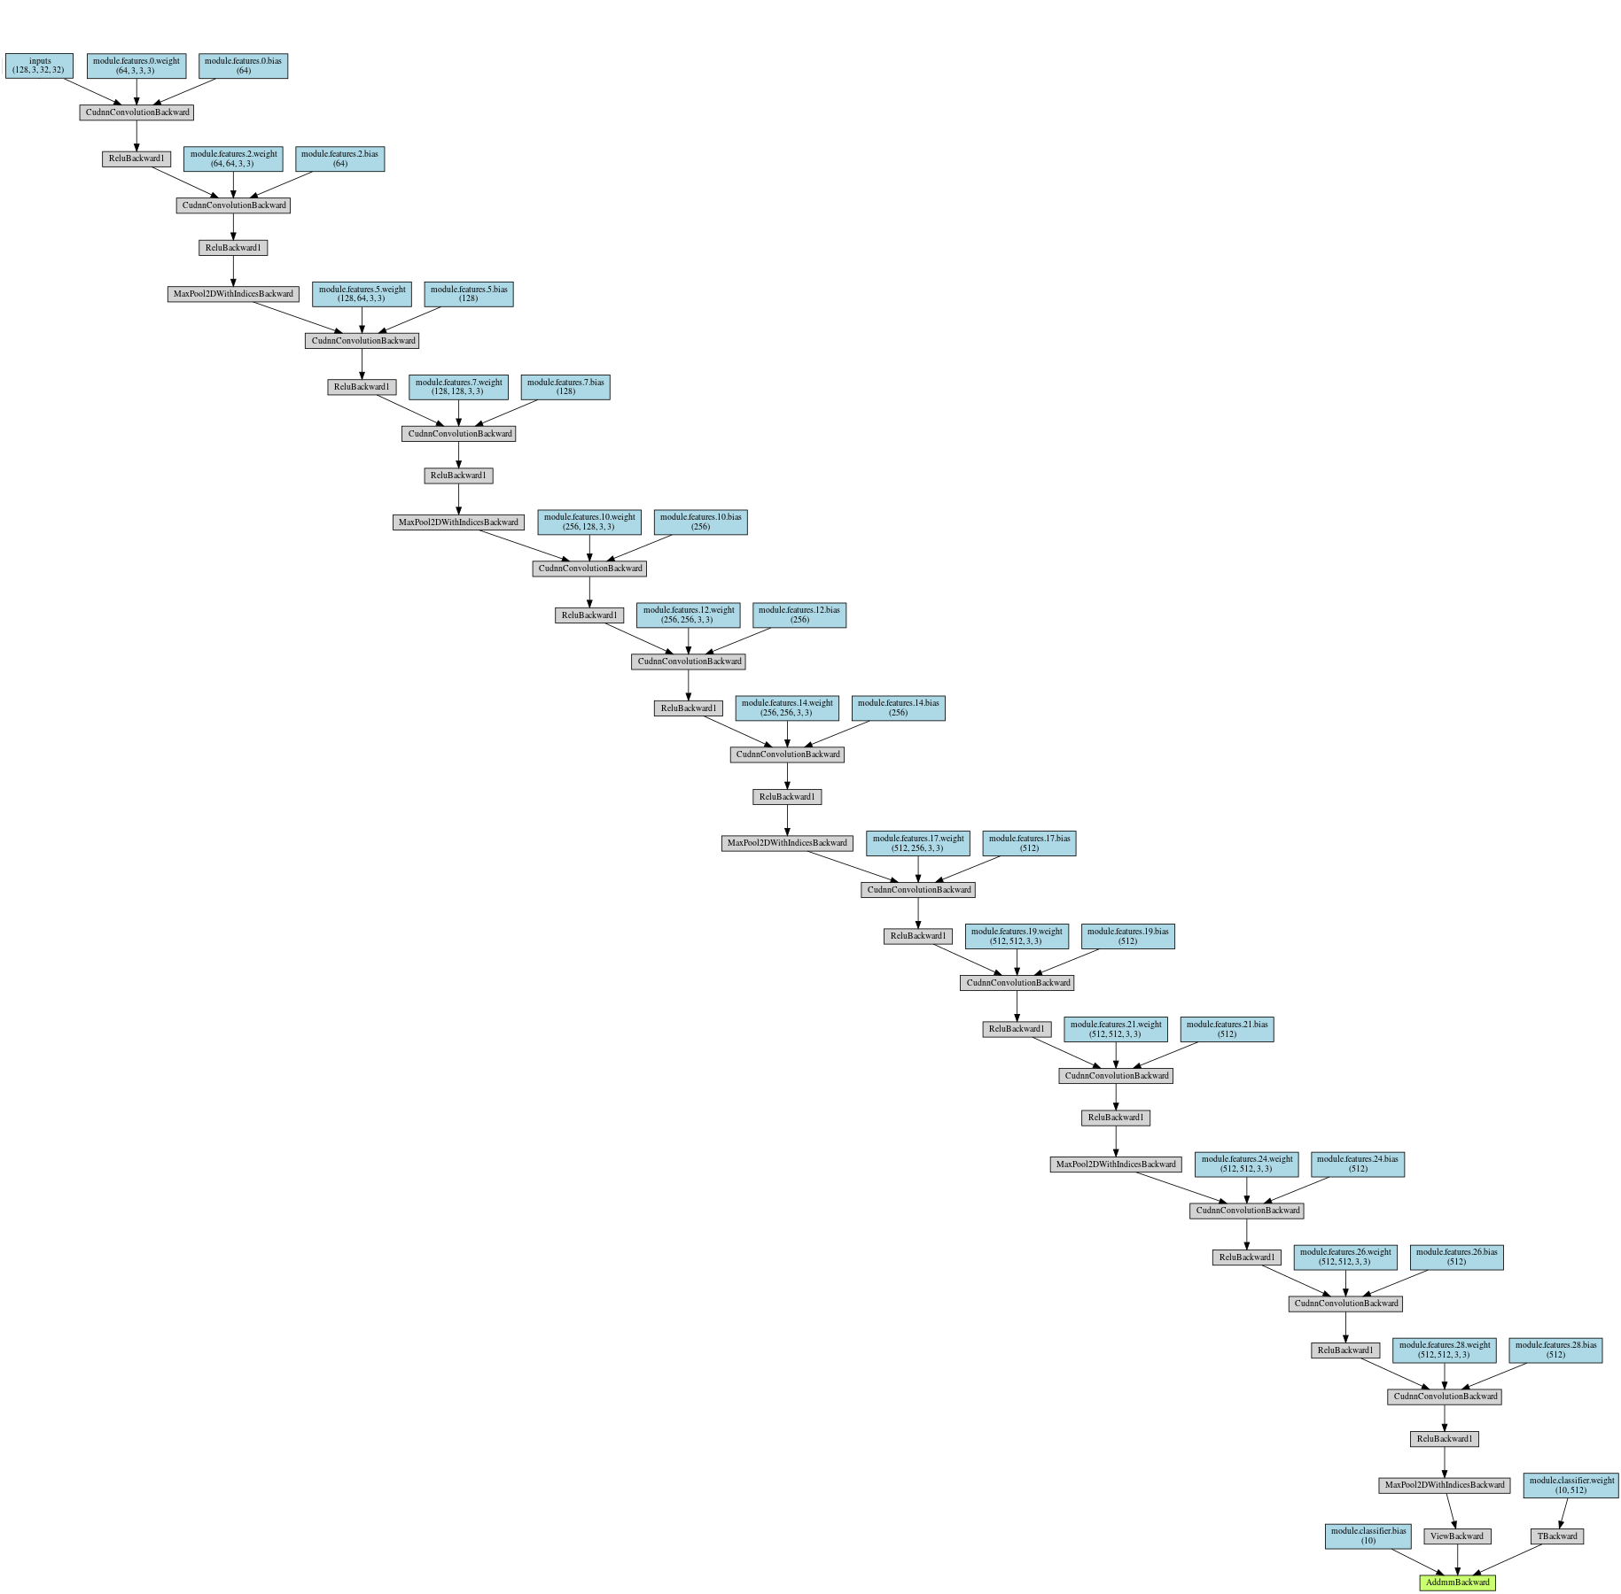
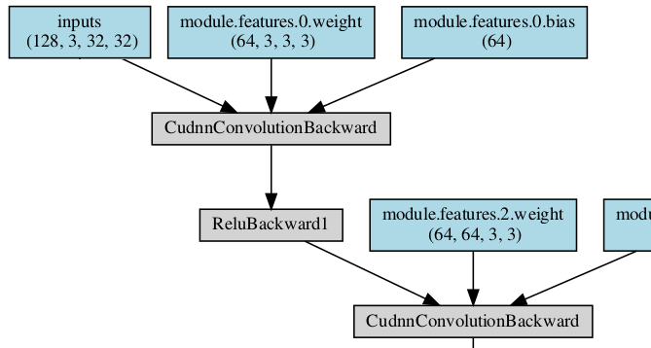
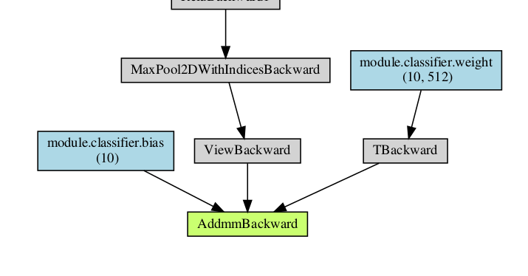
VGG-16 Network

Slide 14
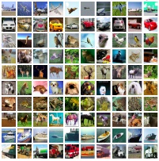














VGG-16
toy
$$Labels$$
Given:
$$(0, 1, 0, 0, …, 0)$$
$$x, y$$
$$t$$
$$(3, 32, 32)$$
$$(0, 0, 1, 0, …, 0)$$
Scalar
Scalar
Function to fit:
$$f=model(images)$$
$$f=k\left(x+y\right)+b$$
$$(0.01, 0.4, 0.02, …, 0.03)$$
Parameters:
$$all the parameters in model$$
$$k, b$$
Loss:
$$G(f, lables)$$
$$G=|f−t|$$
$$Cross entropy$$

Slide 15

















Given:
$$x, y$$
$$t$$
Function:
$$f=k\left(x+y\right)+b$$
Parameters:
$$k, b$$
Loss:
$$G=|f−t|$$
Code…
Graph in pytorch…
Loading dataset…
$$x=torch.tensor([2.4])$$
$$x:2.4$$
$$y:3.3$$
$$t:10.0$$
$$y=torch.tensor([3.3])$$
$$t=torch.tensor([10.0])$$
sum
$$k:1.0$$
Defining parameters…
$$k=torch.tensor(\left[1.0\right], requrires_grad=True)$$
mul
$$b=torch.tensor(\left[0.0\right], requrires_grad=True)$$
sum
$$b:0.0$$
$$f$$
Building a graph…
$$f=k∗\left(x+y\right)+b$$
sub
$$loss=torch.abs(f−t)$$
abs
$$loss$$

Slide 16








Given:
$$x, y$$
$$t$$
Function:
$$f=k\left(x+y\right)+b$$
Parameters:
$$k, b$$
Loss:
$$G=|f−t|$$
Code…
Graph in pytorch…
Loading dataset…
$$x=torch.tensor([2.4])$$
$$x:2.4$$
$$y:3.3$$
$$t:10.0$$
$$y=torch.tensor([3.3])$$
$$t=torch.tensor([10.0])$$
$$k.grad=−5.7$$
sum
$$k:1.0$$
$$k:1.57$$
Defining parameters…
$$k=torch.tensor(\left[1.0\right], requrires_grad=True)$$
mul
$$b=torch.tensor(\left[0.0\right], requrires_grad=True)$$
sum
$$b:0.0$$
$$f$$
$$b:0.1$$
Building a graph…
$$f=k∗\left(x+y\right)+b$$
$$b.grad=−1.0$$
sub
$$loss=torch.abs(f−t)$$
Computing gradients…
$$loss.backward()$$
abs
Updating parameters using Gradient Descent…
$$loss$$
$$k.data=k.data −0.1∗k.grad$$
$$4.3$$
$$b.data=b.data −0.1∗b.grad$$

Slide 17



Given:
$$x, y$$
$$t$$
Function:
$$f=k\left(x+y\right)+b$$
Parameters:
$$k, b$$
Loss:
$$G=|f−t|$$
Code…
Graph in pytorch…
Back propagation again…
$$loss.backward()$$
$$x:2.4$$
$$y:3.3$$
$$t:10.0$$
RuntimeError: Trying to backward through the graph a second time, but the buffers have already been freed. Specify retain_graph=True when calling backward the first time.
sum
$$k.grad=−5.7$$
$$k:1.57$$
mul
sum
$$b:0.1$$
$$f$$
$$b.grad=−1.0$$
sub
abs
$$loss$$
$$4.3$$

Slide 18
Given:
$$x, y$$
$$t$$
Function:
$$f=k\left(x+y\right)+b$$
Parameters:
$$k, b$$
Loss:
$$G=|f−t|$$
Code…
Graph in pytorch…
Back propagation again…
$$x:2.4$$
$$y:3.3$$
$$t:10.0$$
We have to rebuild the graph !
sum
$$k.grad=−5.7$$
$$k:1.57$$
mul
How???
sum
$$b:0.1$$
$$f$$
$$b.grad=−1.0$$
sub
abs
$$loss$$
$$4.3$$

Slide 19


Given:
$$x, y$$
$$t$$
Function:
$$f=k\left(x+y\right)+b$$
Parameters:
$$k, b$$
Loss:
$$G=|f−t|$$
Code…
Graph in pytorch…
Loading dataset…
$$x=torch.tensor([2.4])$$
$$x:2.4$$
$$y:3.3$$
$$t:10.0$$
$$y=torch.tensor([3.3])$$
$$t=torch.tensor([10.0])$$
$$k.grad=−5.7$$
sum
$$k:1.57$$
Defining parameters…
$$k=torch.tensor(\left[1.0\right], requrires_grad=True)$$
mul
$$b=torch.tensor(\left[0.0\right], requrires_grad=True)$$
sum
$$for i in range\left(100\right):$$
$$b:0.1$$
$$f$$
Building a graph…
$$f=k∗\left(x+y\right)+b$$
$$b.grad=−1.0$$
Turn off the lights
sub
$$loss=torch.abs(f−t)$$
Computing gradients…
$$loss.backward()$$
abs
Updating parameters using Gradient Descent…
$$loss$$
$$k.data=k.data −0.1∗k.grad$$
$$4.3$$
$$→0.95$$
$$b.data=b.data −0.1∗b.grad$$

Slide 20






Given:
$$x, y$$
$$t$$
Function:
$$f=k\left(x+y\right)+b$$
Parameters:
$$k, b$$
Loss:
$$G=|f−t|$$
Code…
Graph in pytorch…
Loading dataset…
$$x=torch.tensor([2.4])$$
$$x:2.4$$
$$y:3.3$$
$$t:10.0$$
$$y=torch.tensor([3.3])$$
$$t=torch.tensor([10.0])$$
$$k.grad=−5.7$$
sum
$$k:1.57$$
$$→−11.4$$
Defining parameters…
$$k=torch.tensor(\left[1.0\right], requrires_grad=True)$$
mul
$$b=torch.tensor(\left[0.0\right], requrires_grad=True)$$
sum
$$for i in range\left(100\right):$$
$$b:0.1$$
$$f$$
Building a graph…
$$f=k∗\left(x+y\right)+b$$
$$b.grad=−1.0$$
$$→−2.0$$
sub
$$loss=torch.abs(f−t)$$
Something wrong with the gradients !
Computing gradients…
$$loss.backward()$$
abs
$$loss$$
Updating parameters using Gradient Descent…
$$0.95$$
$$k.data=k.data −0.1∗k.grad$$
$$b.data=b.data −0.1∗b.grad$$

Slide 21









Given:
$$x, y$$
$$t$$
Function:
$$f=k\left(x+y\right)+b$$
Parameters:
$$k, b$$
Loss:
$$G=|f−t|$$
Code…
Graph in pytorch…
Loading dataset…
$$x=torch.tensor([2.4])$$
$$x:2.4$$
$$y:3.3$$
$$t:10.0$$
$$y=torch.tensor([3.3])$$
$$t=torch.tensor([10.0])$$
$$k.grad=−11.4$$
sum
$$k:1.57$$
Defining parameters…
$$k=torch.tensor(\left[1.0\right], requrires_grad=True)$$
mul
$$b=torch.tensor(\left[0.0\right], requrires_grad=True)$$
sum
$$for i in range\left(100\right):$$
$$b:0.1$$
$$f$$
Clearing existing gradients if have…
$$if k.grad is not None:$$
$$k.grad.zero_()$$
$$b.grad=−2.0$$
sub
$$if b.grad is not None:$$
$$b.grad.zero_()$$
Building a graph…
$$f=k∗\left(x+y\right)+b$$
abs
$$loss=torch.abs(f−t)$$
$$loss$$
Computing gradients…
$$loss.backward()$$
$$0.95$$
Updating parameters using Gradient Descent…
$$k.data=k.data −0.1∗k.grad$$
$$b.data=b.data −0.1∗b.grad$$

Slide 22




Given:
$$x, y$$
$$t$$
Function:
$$f=k\left(x+y\right)+b$$
Parameters:
$$k, b$$
Loss:
$$G=|f−t|$$
Code…
Graph in pytorch…
Loading dataset…
$$x=torch.tensor([2.4])$$
$$x:2.4$$
$$y:3.3$$
$$t:10.0$$
$$y=torch.tensor([3.3])$$
$$t=torch.tensor([10.0])$$
$$k.grad=0$$
$$→−5.7$$
sum
$$k:1.57$$
$$k:2.14$$
Defining parameters…
$$k=torch.tensor(\left[1.0\right], requrires_grad=True)$$
mul
$$b=torch.tensor(\left[0.0\right], requrires_grad=True)$$
sum
$$for i in range\left(100\right):$$
$$b:0.1$$
$$f$$
Clearing existing gradients if have…
$$b:0.2$$
$$if k.grad is not None:$$
$$k.grad.zero_()$$
$$b.grad=0$$
$$→−1.0$$
sub
$$if b.grad is not None:$$
$$b.grad.zero_()$$
Building a graph…
$$f=k∗\left(x+y\right)+b$$
abs
$$loss=torch.abs(f−t)$$
$$loss$$
Computing gradients…
$$loss.backward()$$
$$0.95$$
Updating parameters using Gradient Descent…
$$k.data=k.data −0.1∗k.grad$$
$$b.data=b.data −0.1∗b.grad$$

Slide 23


















Given:
$$x, y$$
$$t$$
Function:
$$f=k\left(x+y\right)+b$$
Parameters:
$$k, b$$
Loss:
$$G=|f−t|$$
Code…
Graph in pytorch…
Loading dataset…
$$x=torch.tensor([2.4])$$
$$x:2.4$$
$$y:3.3$$
$$t:10.0$$
$$y=torch.tensor([3.3])$$
$$t=torch.tensor([10.0])$$
$$k.grad=0$$
$$→−5.7$$
sum
$$k:1.57$$
$$k:2.14$$
Defining parameters…
$$k=torch.tensor(\left[1.0\right], requrires_grad=True)$$
mul
$$b=torch.tensor(\left[0.0\right], requrires_grad=True)$$
sum
$$for i in range\left(100\right):$$
$$b:0.1$$
$$f$$
Clearing existing gradients if have…
$$b:0.2$$
$$if k.grad is not None:$$
$$k.grad.zero_()$$
$$b.grad=0$$
$$→−1.0$$
sub
$$if b.grad is not None:$$
$$loss$$
$$k$$
$$b$$
$$b.grad.zero_()$$
Building a graph…
$$4.3$$
$$1.0$$
$$0.0$$
$$f=k∗\left(x+y\right)+b$$
$$0.95$$
$$1.57$$
$$0.1$$
abs
$$loss=torch.abs(f−t)$$
$$2.39$$
$$2.14$$
$$0.2$$
$$loss$$
Computing gradients…
$0.$1
$$loss.backward()$$
$$0.95$$
$1.$57
$$0.95$$
Updating parameters using Gradient Descent…
$2.3$9
$$2.14$$
$0.$2
$$k.data=k.data −0.1∗k.grad$$
$$0.95$$
$$1.57$$
$0.$1
$$b.data=b.data −0.1∗b.grad$$

Slide 24
Given:
$$x, y$$
$$t$$
Function:
$$f=k\left(x+y\right)+b$$
Parameters:
$$k, b$$
Loss:
$$G=|f−t|$$
Code…
Loading dataset…
$$x=torch.tensor([2.4])$$
$$y=torch.tensor([3.3])$$
$$t=torch.tensor([10.0])$$
How to be more pytorch-style ?
Defining parameters…
$$k=torch.tensor(\left[1.0\right], requrires_grad=True)$$
$$b=torch.tensor(\left[0.0\right], requrires_grad=True)$$
Optimizer?
$$for i in range\left(100\right):$$
Clearing existing gradients if have…
$$if k.grad is not None:$$
Module?
$$k.grad.zero_()$$
$$if b.grad is not None:$$
$$b.grad.zero_()$$
Building a graph…
$$f=k∗\left(x+y\right)+b$$
$$loss=torch.abs(f−t)$$
Computing gradients…
$$loss.backward()$$
Updating parameters using Gradient Descent…
$$k.data=k.data −0.1∗k.grad$$
$$b.data=b.data −0.1∗b.grad$$

Slide 25
Given:
$$x, y$$
$$t$$
Function:
$$f=k\left(x+y\right)+b$$
Parameters:
$$k, b$$
Loss:
$$G=|f−t|$$
Code…
Loading dataset…
$$x=torch.tensor([2.4])$$
$$y=torch.tensor([3.3])$$
Adding an optimizer…
$$t=torch.tensor([10.0])$$
Defining parameters…
An optimizer object will hold the current state and will update the parameters based on the computed gradients.
$$k=torch.tensor(\left[1.0\right], requrires_grad=True)$$
$$b=torch.tensor(\left[0.0\right], requrires_grad=True)$$
$$for i in range\left(100\right):$$
Clearing existing gradients if have…
torch.optim.SGD(params,
lr=<required parameter>,
momentum=0,
dampening=0,
weight_decay=0,
nesterov=False)
$$if k.grad is not None:$$
$$k.grad.zero_()$$
optimizer =
torch.optim.SGD([k, b], lr=0.1)
$$if b.grad is not None:$$
$$b.grad.zero_()$$
Building a graph…
$$f=k∗\left(x+y\right)+b$$
$$loss=torch.abs(f−t)$$
Computing gradients…
$$loss.backward()$$
Updating parameters using Gradient Descent…
$$k.data=k.data −0.1∗k.grad$$
$$b.data=b.data −0.1∗b.grad$$

Slide 26






Given:
$$x, y$$
$$t$$
Function:
$$f=k\left(x+y\right)+b$$
Parameters:
$$k, b$$
Loss:
$$G=|f−t|$$
Code…
Adding an optimizer…
Loading dataset…
Loading dataset…
$$x=torch.tensor([2.4])$$
$$x=torch.tensor([2.4])$$
$$y=torch.tensor([3.3])$$
$$y=torch.tensor([3.3])$$
$$t=torch.tensor([10.0])$$
$$t=torch.tensor([10.0])$$
Defining parameters…
$$k=torch.tensor(\left[1.0\right], requrires_grad=Tue)$$
Defining parameters…
$$b=torch.tensor(\left[0.0\right], requrires_grad=Tue)$$
$$k=torch.tensor(\left[1.0\right], requrires_grad=True)$$
$$b=torch.tensor(\left[0.0\right], requrires_grad=True)$$
$$optimizer=torch.optim.SGD(\left[k, b\right], lr=0.1)$$
$$for i in range\left(100\right):$$
$$for i in range\left(100\right):$$
Clearing existing gradients if have…
Clearing existing gradients if have…
$$if k.grad is not None:$$
$$optimizer.zero_grad()$$
1
$$k.grad.zero_()$$
1
$$if b.grad is not None:$$
Building a graph…
$$b.grad.zero_()$$
Building a graph…
$$f=k∗\left(x+y\right)+b$$
$$f=k∗\left(x+y\right)+b$$
$$loss=torch.abs(f−t)$$
$$loss=torch.abs(f−t)$$
Computing gradients…
Computing gradients…
$$loss.backward()$$
$$loss.backward()$$
Updating parameters using Gradient Descent…
Updating parameters using Gradient Descent…
$$optimizer.step()$$
2
$$k.data=k.data −0.1∗k.grad$$
2
$$b.data=b.data −0.1∗b.grad$$

Slide 27















Given:
$$x, y$$
$$t$$
Function:
$$f=k\left(x+y\right)+b$$
Parameters:
$$k, b$$
Loss:
$$G=|f−t|$$
Adding an optimizer…
Loading dataset…
$$x=torch.tensor([2.4])$$
$$y=torch.tensor([3.3])$$
$$t=torch.tensor([10.0])$$
Defining parameters…
Constructing a module…
$$k=torch.tensor(\left[1.0\right], requrires_grad=True)$$
$$b=torch.tensor(\left[0.0\right], requrires_grad=True)$$
Base class for all neural network modules: torch.nn.Module
Your models should also subclass this class.
$$optimizer=torch.optim.SGD(\left[k, b\right], lr=0.1)$$
$$for i in range\left(100\right):$$
Clearing existing gradients if have…
$$optimizer.zero_grad()$$
$$class Mymodel\left(torch.nn.Module\right):$$
$$def __init__(self):$$
Building a graph…
$$super().__init__()$$
$$f=k∗\left(x+y\right)+b$$
$$\# customer code here…$$
$$loss=torch.abs(f−t)$$
Here, define parameters using torch.nn.parameter
Computing gradients…
$$loss.backward()$$
Updating parameters using Gradient Descent…
$$def forward(self, x):$$
$$optimizer.step()$$
$$\# customer code here…$$
$$out=operations on x$$
$$return out$$

Slide 28









Given:
$$x, y$$
$$t$$
Function:
$$f=k\left(x+y\right)+b$$
Parameters:
$$k, b$$
Loss:
$$G=|f−t|$$
Adding an optimizer…
Constructing a module…
Loading dataset…
$$class Mymodel\left(torch.nn.Module\right):$$
$$x=torch.tensor([2.4])$$
$$def __init__(self):$$
$$y=torch.tensor([3.3])$$
$$super().__init__()$$
$$t=torch.tensor([10.0])$$
$$\# customer code here…$$
Defining parameters…
Here, define parameters using torch.nn.parameter
$$k=torch.tensor(\left[1.0\right], requrires_grad=True)$$
$$b=torch.tensor(\left[0.0\right], requrires_grad=True)$$
$$def forward(self, x):$$
$$\# customer code here…$$
$$optimizer=torch.optim.SGD(\left[k, b\right], lr=0.1)$$
$$out=operations on x$$
$$for i in range\left(100\right):$$
$$return out$$
Clearing existing gradients if have…
$$optimizer.zero_grad()$$
$$from torch.nn.parameter import Parameter$$
$$class Mymodel\left(torch.nn.Module\right):$$
Building a graph…
$$def __init__(self):$$
$$f=k∗\left(x+y\right)+b$$
$$super().__init__()$$
$$loss=torch.abs(f−t)$$
$$self.k=Parameter(torch.tensor([1.0]))$$
Computing gradients…
$$loss.backward()$$
$$self.b=Parameter(torch.tensor([0.0]))$$
Updating parameters using Gradient Descent…
$$def forward(self, x):$$
$$optimizer.step()$$
$$f=self.k∗torch.sum\left(x\right)+self.b$$
$$return f$$

Slide 29

















Given:
$$x, y$$
$$t$$
Function:
$$f=k\left(x+y\right)+b$$
Parameters:
$$k, b$$
Loss:
$$G=|f−t|$$
Adding an optimizer…
Pytorch-style code…
Loading dataset…
$$class Mymodel\left(torch.nn.Module\right):$$
$$x=torch.tensor([2.4])$$
$$def __init__(self):$$
$$super().__init__()$$
$$y=torch.tensor([3.3])$$
$$self.k=Parameter(torch.tensor([1.0]))$$
1
$$t=torch.tensor([10.0])$$
$$self.b=Parameter(torch.tensor([0.0]))$$
Defining parameters…
$$def forward(self, x):$$
$$k=torch.tensor(\left[1.0\right], requrires_grad=True)$$
$$f=self.k∗torch.sum\left(x\right)+self.b$$
2
1
$$return f$$
$$b=torch.tensor(\left[0.0\right], requrires_grad=True)$$
Loading dataset…
$$x=torch.tensor([2.4])$$
$$optimizer=torch.optim.SGD(\left[k, b\right], lr=0.1)$$
$$optimizer=torch.optim.SGD(\left[k, b\right], lr=0.1)$$
$$y=torch.tensor([3.3])$$
$$t=torch.tensor([10.0])$$
$$for i in range\left(100\right):$$
Instantiate a model…
Clearing existing gradients if have…
$$my_model=Mymodel()$$
$$optimizer.zero_grad()$$
$$optimizer=torch.optim.SGD(my_model.parameters(),lr=0.1)$$
Building a graph…
$$for i in range\left(100\right):$$
Clearing existing gradients if have…
$$f=k∗\left(x+y\right)+b$$
2
$$optimizer.zero_grad()$$
$$loss=torch.abs(f−t)$$
Building a graph…
Computing gradients…
$$input=torch.cat((x, y))$$
$$f=my_model(input)$$
2
$$loss.backward()$$
$$loss=torch.abs(f−t)$$
Updating parameters using Gradient Descent…
Computing gradients…
$$optimizer.step()$$
$$loss.backward()$$
Updating parameters using Gradient Descent…
$$optimizer.step()$$

Slide 30








Given:
$$x, y$$
$$t$$
Function:
$$f=k\left(x+y\right)+b$$
Parameters:
$$k, b$$
Loss:
$$G=|f−t|$$
Pytorch-style code…
$$class Mymodel\left(torch.nn.Module\right):$$
$$def __init__(self):$$
$$super().__init__()$$
$$self.k=Parameter(torch.tensor([1.0]))$$
$$self.b=Parameter(torch.tensor([0.0]))$$
$$def forward(self, x):$$
$$f=self.k∗torch.sum\left(x\right)+self.b$$
How to run it on GPU?
$$return f$$
Loading dataset…
$$x=torch.tensor([2.4])$$
$$y=torch.tensor([3.3])$$
$$t=torch.tensor([10.0])$$
Instantiate a model…
Store all the data and the model on GPU, then GPU would be used.
$$my_model=Mymodel()$$
$$optimizer=torch.optim.SGD(my_model.parameters(),lr=0.1)$$
$$for i in range\left(100\right):$$
Clearing existing gradients if have…
$$optimizer.zero_grad()$$
Building a graph…
$$input=torch.cat((x, y))$$
$$f=my_model(input)$$
$$loss=torch.abs(f−t)$$
Computing gradients…
$$loss.backward()$$
Updating parameters using Gradient Descent…
$$optimizer.step()$$

Slide 31


















Given:
$$x, y$$
$$t$$
Function:
$$f=k\left(x+y\right)+b$$
Parameters:
$$k, b$$
Loss:
$$G=|f−t|$$
Pytorch-style code…
Pytorch-style code running on GPU…
$$class Mymodel\left(torch.nn.Module\right):$$
$$class Mymodel\left(torch.nn.Module\right):$$
$$def __init__(self):$$
$$def __init__(self):$$
$$super().__init__()$$
$$super().__init__()$$
$$self.k=Parameter(torch.tensor([1.0]))$$
$$self.k=Parameter(torch.tensor([1.0]))$$
$$self.b=Parameter(torch.tensor([0.0]))$$
$$self.b=Parameter(torch.tensor([0.0]))$$
$$def forward(self, x):$$
$$def forward(self, x):$$
$$f=self.k∗torch.sum\left(x\right)+self.b$$
$$f=self.k∗torch.sum\left(x\right)+self.b$$
$$return f$$
$$return f$$
Loading dataset…
Loading dataset…
$$x=torch.tensor([2.4])$$
$$x=torch.tensor([2.4])$$
$$y=torch.tensor([3.3])$$
$$y=torch.tensor([3.3])$$
$$t=torch.tensor([10.0])$$
$$t=torch.tensor([10.0])$$
Instantiate a model…
Instantiate a model…
$$my_model=Mymodel()$$
$$my_model=Mymodel()$$
$$.cuda()$$
$$optimizer=torch.optim.SGD(my_model.parameters(),lr=0.1)$$
$$optimizer=torch.optim.SGD(my_model.parameters(),lr=0.1)$$
$$for i in range\left(100\right):$$
$$for i in range\left(100\right):$$
Clearing existing gradients if have…
Clearing existing gradients if have…
$$optimizer.zero_grad()$$
$$optimizer.zero_grad()$$
Building a graph…
Building a graph…
$$input=torch.cat((x, y))$$
$$input=torch.cat((x, y))$$
$$.cuda()$$
$$f=my_model(input)$$
$$f=my_model(input)$$
$$.cuda()$$
$$loss=torch.abs(f−t)$$
$$loss=torch.abs(f−t )$$
Computing gradients…
Computing gradients…
$$loss.backward()$$
$$loss.backward()$$
Updating parameters using Gradient Descent…
Updating parameters using Gradient Descent…
$$optimizer.step()$$
$$optimizer.step()$$

Slide 32
Now, let’s see what a actual CNN model looks like?

Slide 33
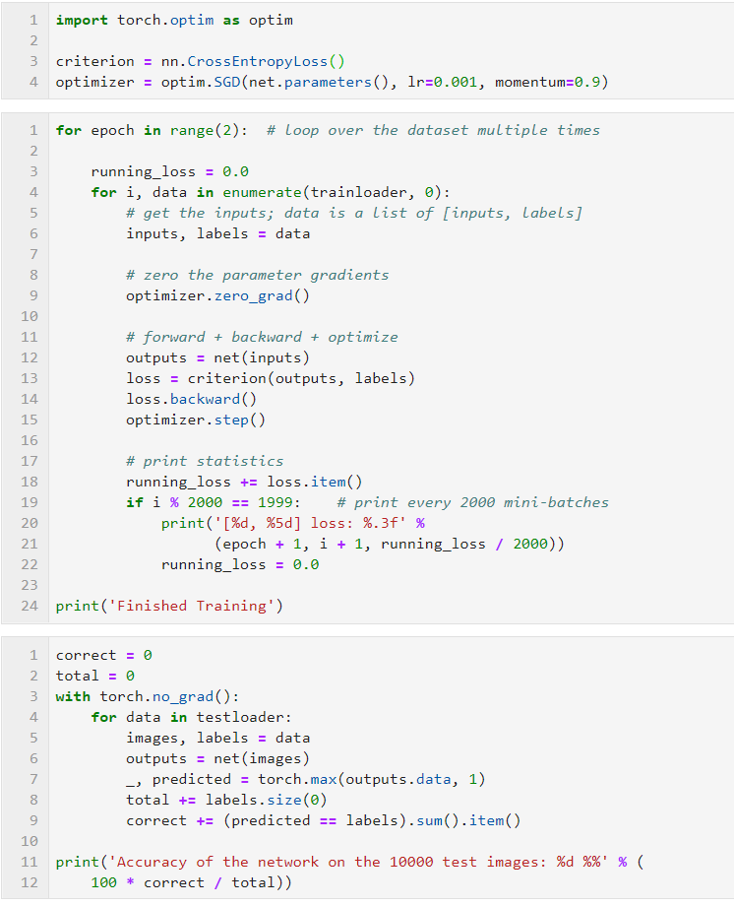
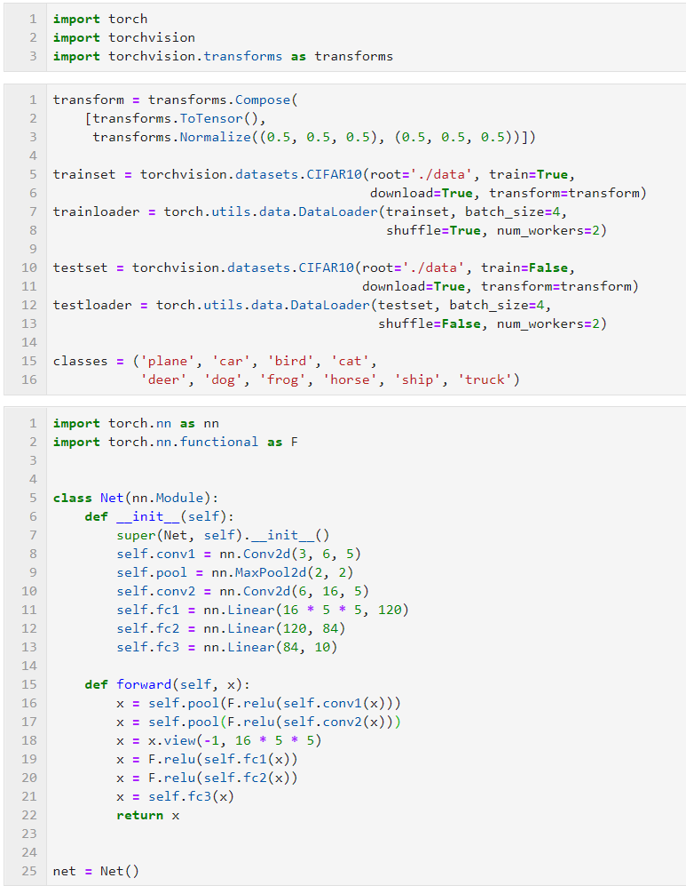
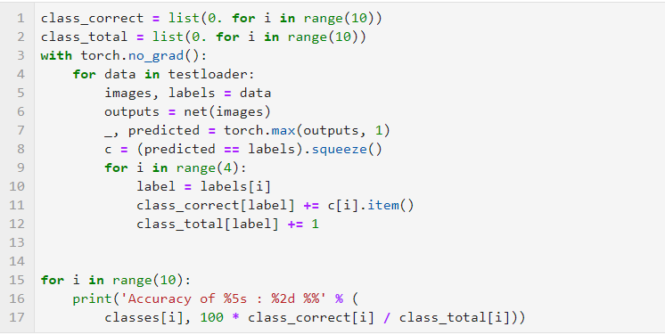



$$Labels$$
$$(0, 1, 0, 0, …, 0)$$
Source code:
$$(0, 0, 1, 0, …, 0)$$
https://pytorch.org/tutorials/beginner/blitz/cifar10_tutorial.html#sphx-glr-beginner-blitz-cifar10-tutorial-py

Slide 34
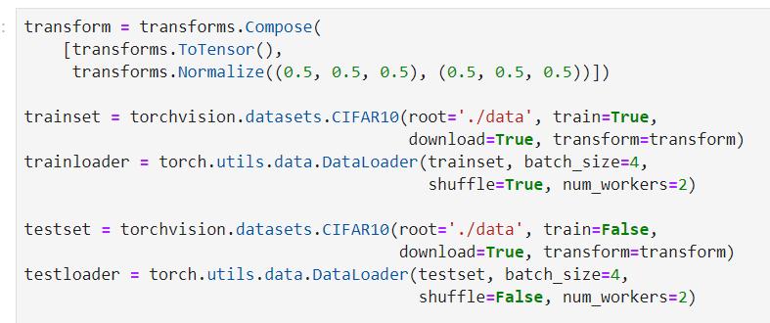










Pytorch-style code…
$$class Mymodel\left(torch.nn.Module\right):$$
$$def __init__(self):$$
$$super().__init__()$$
$$self.k=Parameter(torch.tensor([1.0]))$$
$$self.b=Parameter(torch.tensor([0.0]))$$
$$def forward(self, x):$$
$$f=self.k∗torch.sum\left(x\right)+self.b$$
$$return f$$
Loading dataset…
$$x=torch.tensor([2.4])$$
$$y=torch.tensor([3.3])$$
$$t=torch.tensor([10.0])$$
Instantiate a model…
$$my_model=Mymodel()$$
$$optimizer=torch.optim.SGD(my_model.parameters(),lr=0.1)$$
$$for i in range\left(100\right):$$
Clearing existing gradients if have…
$$optimizer.zero_grad()$$
Building a graph…
$$input=torch.cat((x, y))$$
Dataset on pytorch:
1. https://pytorch.org/tutorials/beginner/data_loading_tutorial.html
2. https://pytorch.org/tutorials/beginner/blitz/cifar10_tutorial.html#sphx-glr-beginner-blitz-cifar10-tutorial-py
3. https://pytorch.org/docs/stable/torchvision/index.html
$$f=my_model(input)$$
$$loss=torch.abs(f−t)$$
Computing gradients…
$$loss.backward()$$
Updating parameters using Gradient Descent…
$$optimizer.step()$$

Slide 35
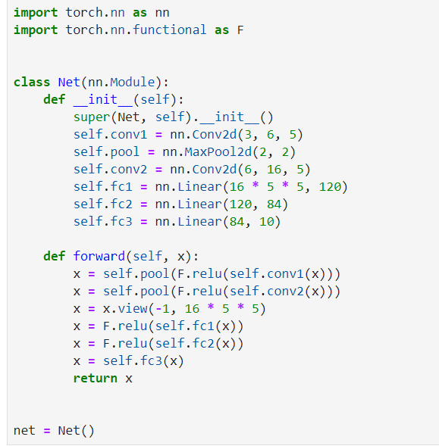
Pytorch-style code…
$$class Mymodel\left(torch.nn.Module\right):$$
$$def __init__(self):$$
$$super().__init__()$$
$$self.k=Parameter(torch.tensor([1.0]))$$
$$self.b=Parameter(torch.tensor([0.0]))$$
$$def forward(self, x):$$
$$f=self.k∗torch.sum\left(x\right)+self.b$$
$$return f$$
Loading dataset…
$$x=torch.tensor([2.4])$$
$$y=torch.tensor([3.3])$$
$$t=torch.tensor([10.0])$$
Instantiate a model…
$$my_model=Mymodel()$$
$$optimizer=torch.optim.SGD(my_model.parameters(),lr=0.1)$$
$$for i in range\left(100\right):$$
Clearing existing gradients if have…
$$optimizer.zero_grad()$$
Building a graph…
$$input=torch.cat((x, y))$$
$$f=my_model(input)$$
$$loss=torch.abs(f−t)$$
Computing gradients…
$$loss.backward()$$
Updating parameters using Gradient Descent…
$$optimizer.step()$$

Slide 36
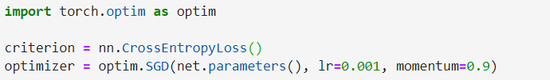










Pytorch-style code…
$$class Mymodel\left(torch.nn.Module\right):$$
$$def __init__(self):$$
$$super().__init__()$$
$$self.k=Parameter(torch.tensor([1.0]))$$
In our case, we could define a criterion like that:
$$self.b=Parameter(torch.tensor([0.0]))$$
$$def forward(self, x):$$
$$def AbsLoss():$$
$$def get_abs(a, b):$$
$$f=self.k∗torch.sum\left(x\right)+self.b$$
$$return torch.abs(a−b):$$
$$return f$$
$$return get_abs$$
Loading dataset…
$$x=torch.tensor([2.4])$$
$$criterion=AbsLoss()$$
$$y=torch.tensor([3.3])$$
$$…$$
$$t=torch.tensor([10.0])$$
$$for i in range\left(100\right):$$
Instantiate a model…
$$…$$
$$my_model=Mymodel()$$
$$loss=criterion(f, t)$$
$$…$$
$$optimizer=torch.optim.SGD(my_model.parameters(),lr=0.1)$$
$$for i in range\left(100\right):$$
Clearing existing gradients if have…
$$optimizer.zero_grad()$$
Building a graph…
$$input=torch.cat((x, y))$$
$$f=my_model(input)$$
$$loss=torch.abs(f−t)$$
Computing gradients…
$$loss.backward()$$
Updating parameters using Gradient Descent…
$$optimizer.step()$$

Slide 37
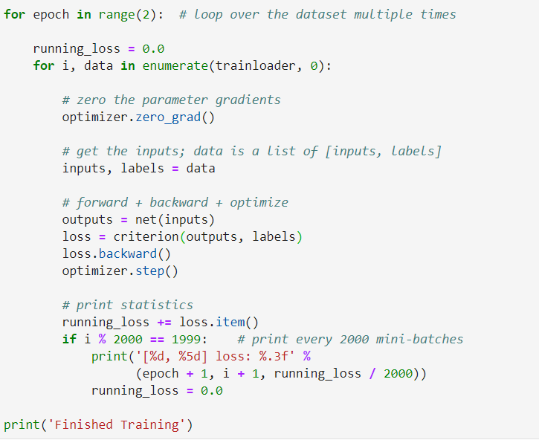
Pytorch-style code…
$$class Mymodel\left(torch.nn.Module\right):$$
$$def __init__(self):$$
$$super().__init__()$$
$$self.k=Parameter(torch.tensor([1.0]))$$
$$self.b=Parameter(torch.tensor([0.0]))$$
$$def forward(self, x):$$
$$f=self.k∗torch.sum\left(x\right)+self.b$$
$$return f$$
Loading dataset…
$$x=torch.tensor([2.4])$$
$$y=torch.tensor([3.3])$$
$$t=torch.tensor([10.0])$$
Instantiate a model…
$$my_model=Mymodel()$$
$$optimizer=torch.optim.SGD(my_model.parameters(),lr=0.1)$$
$$for i in range\left(100\right):$$
Clearing existing gradients if have…
$$optimizer.zero_grad()$$
Building a graph…
$$input=torch.cat((x, y))$$
$$f=my_model(input)$$
$$loss=torch.abs(f−t)$$
Computing gradients…
$$loss.backward()$$
Updating parameters using Gradient Descent…
$$optimizer.step()$$

Slide 38
?
Please see the source code, and check what happened.

Slide 39
Useful links for using Pytorch:
https://pytorch.org/tutorials/index.html
https://pytorch.org/docs/stable/index.html
https://simpleanalytical.com/how-install-anaconda-windows

Slide 40
“Read enough to develop your intuitions, then trust your intuitions.”
Geoffrey Hinton
Thanks for listening

